Slide 1
Backpropagation

Slide 2
x1
w1
b1
a1
w2
w7
x2
w3
b3
Y^
w4
a3
w5
b2
w8
x3
w6
a2

Slide 3
Mathematically
Wnew=Wold − η * ∂L​ / ∂ Wold
where:
η is the learning rate,
L is the loss function, and
∂L / ∂W​ is the gradient of loss with respect to weights.

Slide 4
Learning Rate
The learning rate (η) is one of the most important hyperparameters in the training of a neural network. It controls how much the weights are adjusted during each step of the optimization process (like gradient descent).
If too high → unstable training or divergence.
If too low → extremely slow learning.

Slide 5
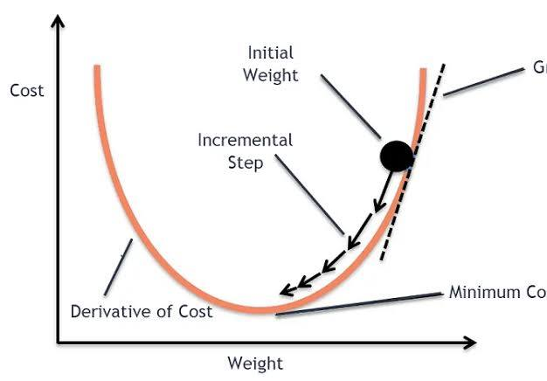

Slide 6
Vanishing Gradient
What it is:
Gradients (used to update weights) become extremely small as they are backpropagated through many layers.
This causes early layers to learn very slowly or not at all.

Slide 7
Effects on Training
Slow convergence or no learning in deep networks.
Model may get stuck at high loss values.
Training accuracy improves very slowly or not at all.
Especially common when sigmoid is used in hidden layers.

Slide 8
How to prevent Vanishing Gradient
Use better activation functions (ReLU, Leaky ReLU)
Batch Normalization

Slide 9
Overfitting
When we train a neural network, our goal is to make it generalize well — that means it should perform well not only on the training data but also on new, unseen data (like test data).
However, sometimes the model memorizes the training data instead of learning patterns from it. When that happens, the model performs very well on training data but poorly on test data.

Slide 10
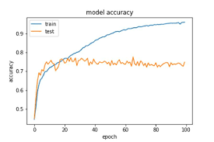
Overfitting

Slide 11
Overfitting
Too many parameters (model too complex for the data).
Not enough training data.
Noisy data or poor data preprocessing.
Too many training epochs (the model keeps learning specific patterns).

Slide 12
How to prevent overfitting
Early stopping (stop training before overfitting starts)
Data augmentation (add variations to data)
Regularization (like L1, L2 penalties)
And Dropout

Slide 13
Dropout
If the same few students always do all the work, the others won’t learn much. So, in each session, you randomly ask some students to sit out (dropout). Now, every student must learn to contribute — that leads to a more robust and general team.

Slide 14
Dropouts
from tensorflow.keras.models import Sequential
from tensorflow.keras.layers import Dense, Dropout
model = Sequential([
Dense(128, activation='relu', input_dims = 23)),
Dropout(0.5), # Drop 50% of neurons during training
Dense(64, activation='relu'),
Dropout(0.3), # Drop 30% here
Dense(10, activation='softmax’)
])

